Slide 1
Automation and control
Dr. Salman Hussain

Slide 2
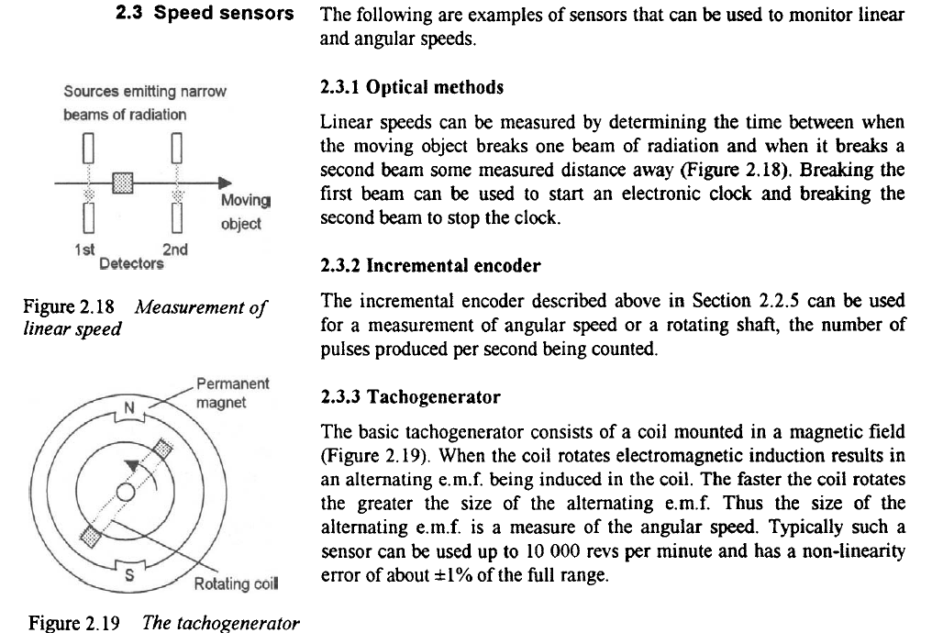

Slide 3
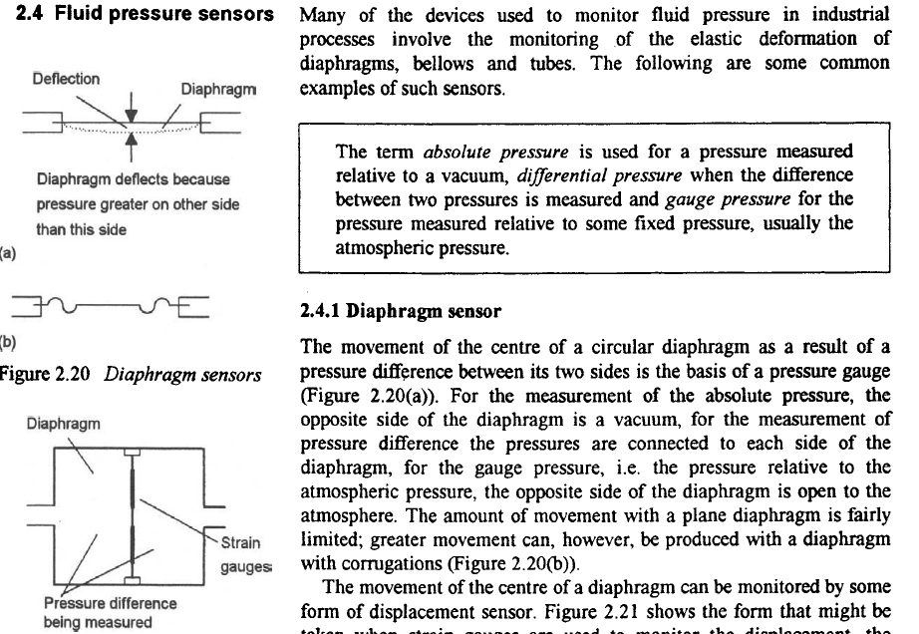

Slide 4
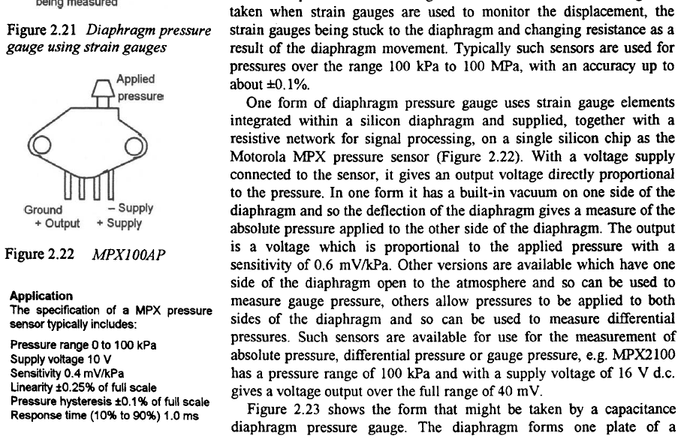

Slide 5
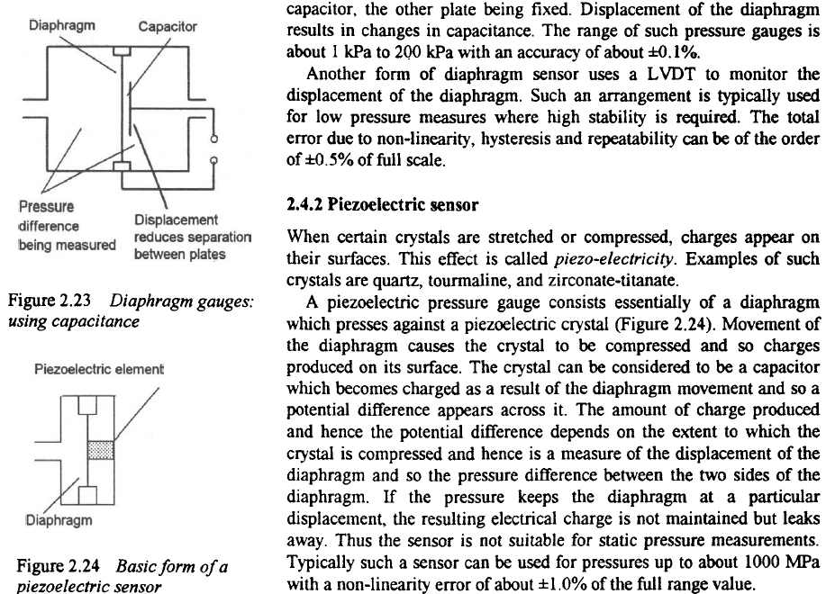

Slide 6
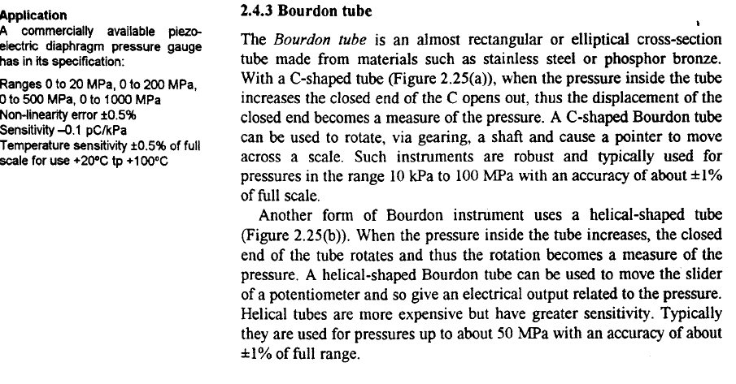

Slide 7
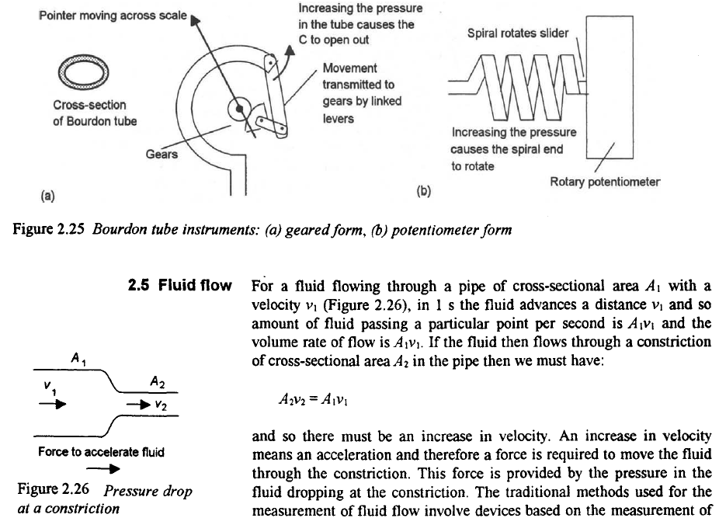

Slide 8
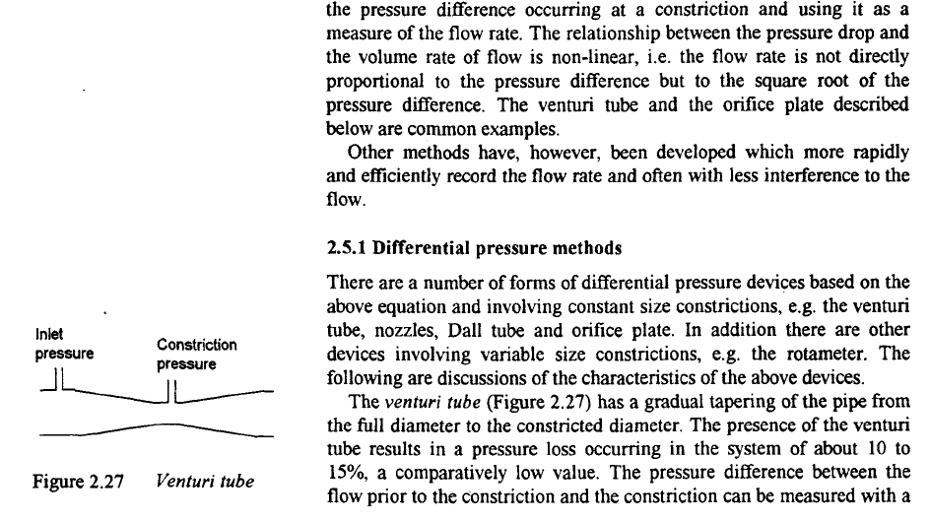

Slide 9
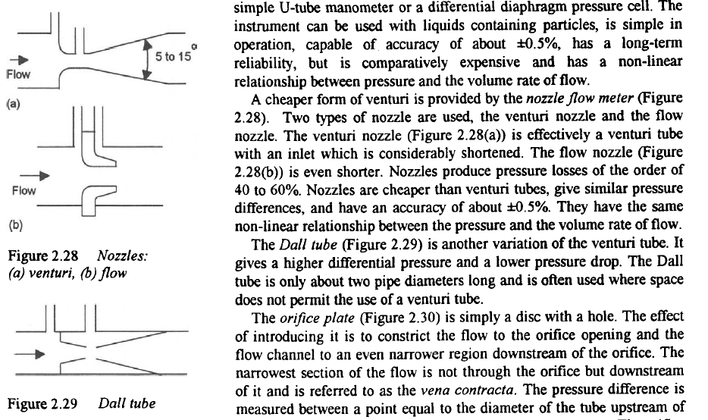

Slide 10
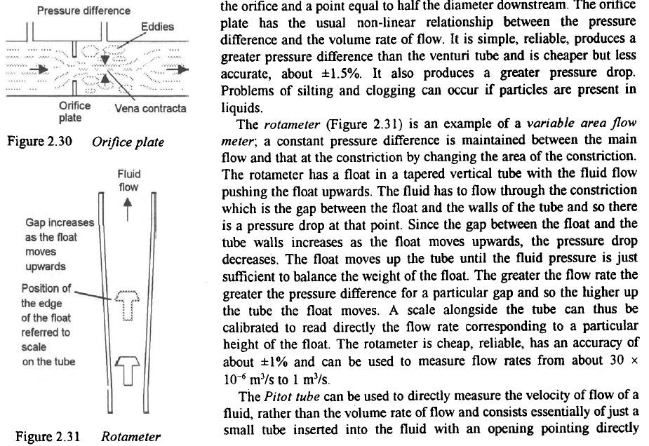

Slide 11
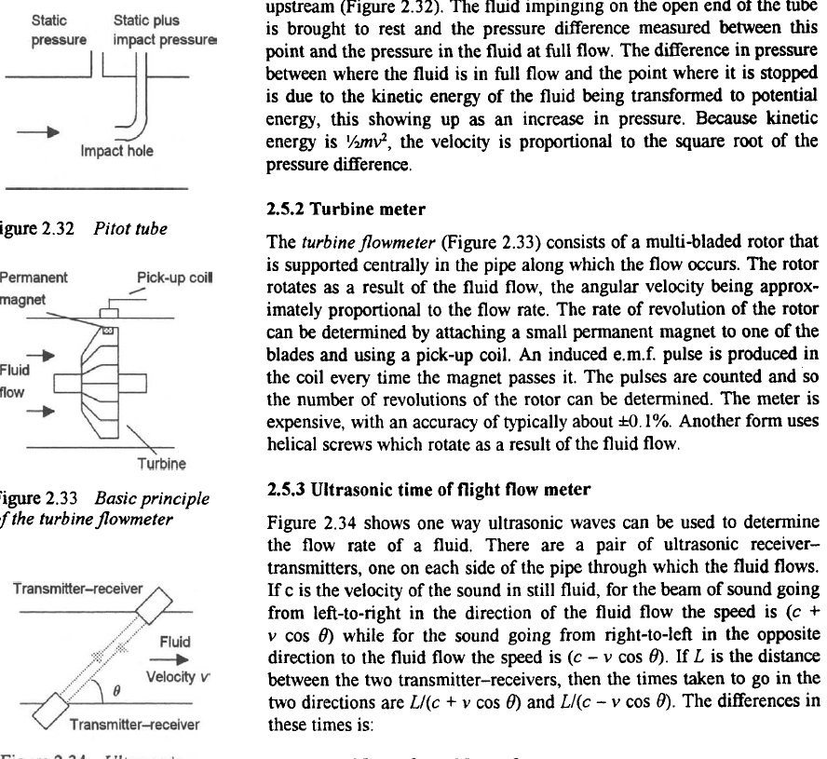

Slide 12
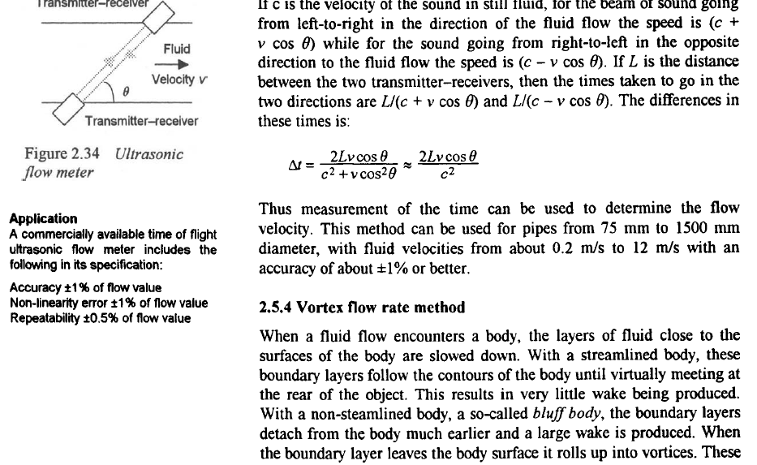

Slide 13
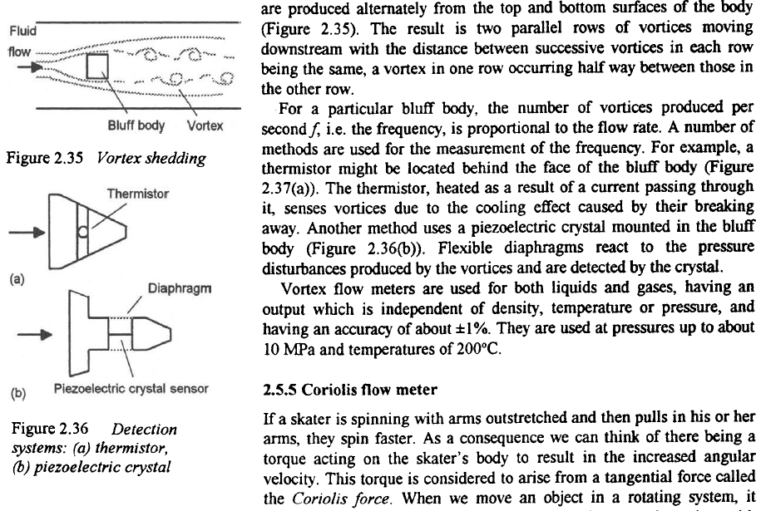

Slide 14
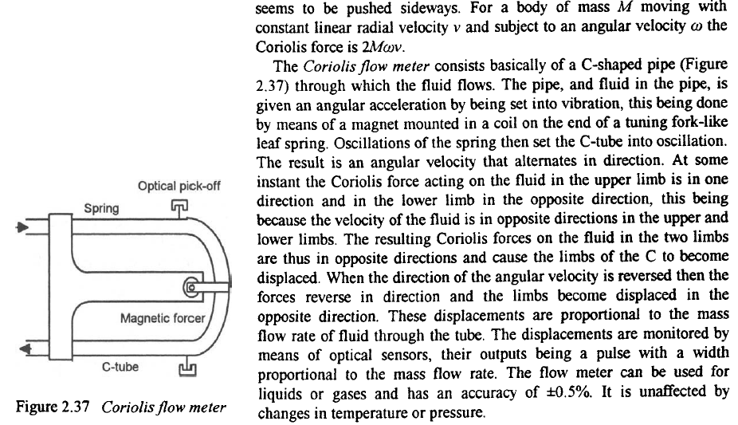

Slide 15
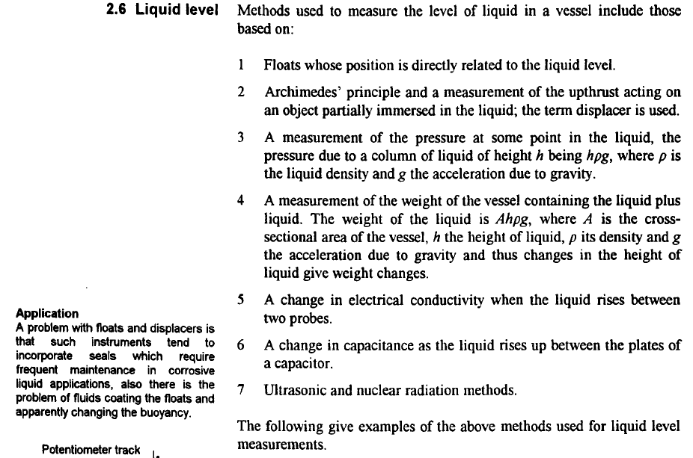

Slide 16
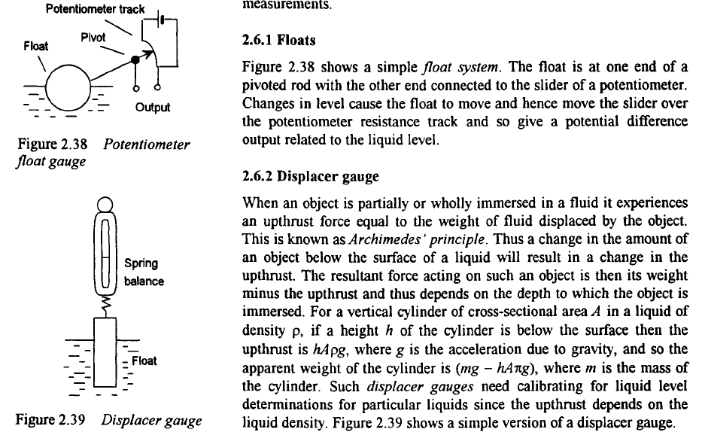

Slide 17
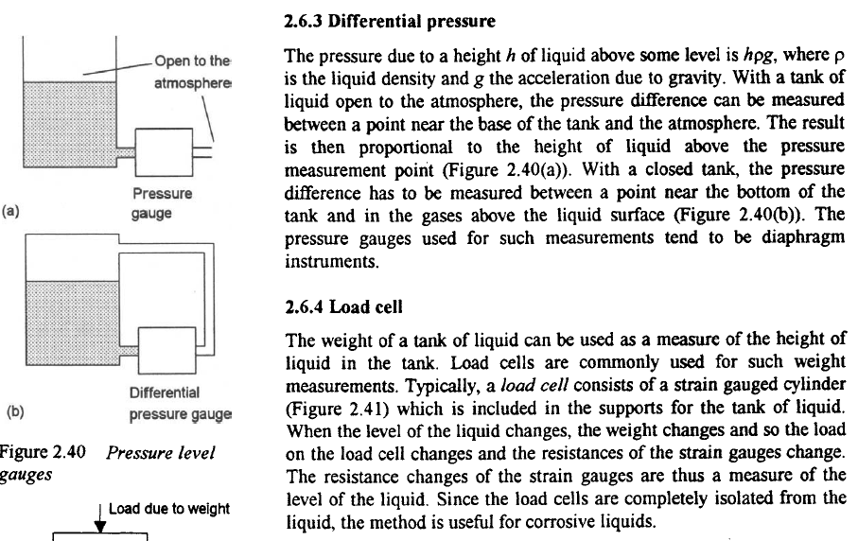

Slide 18
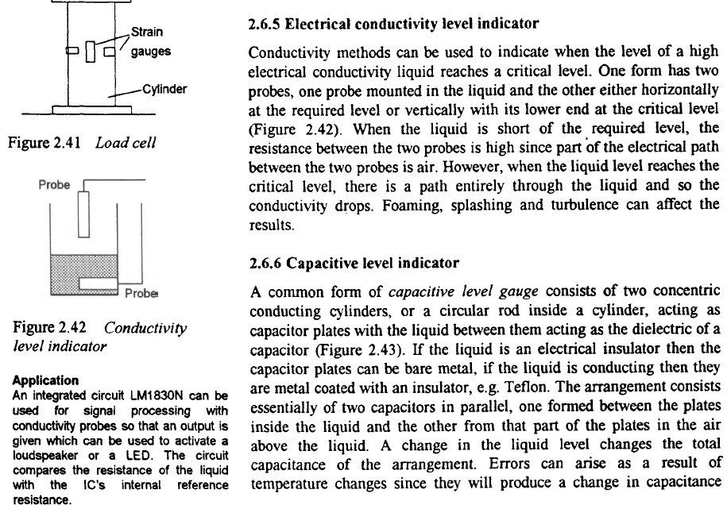

Slide 19
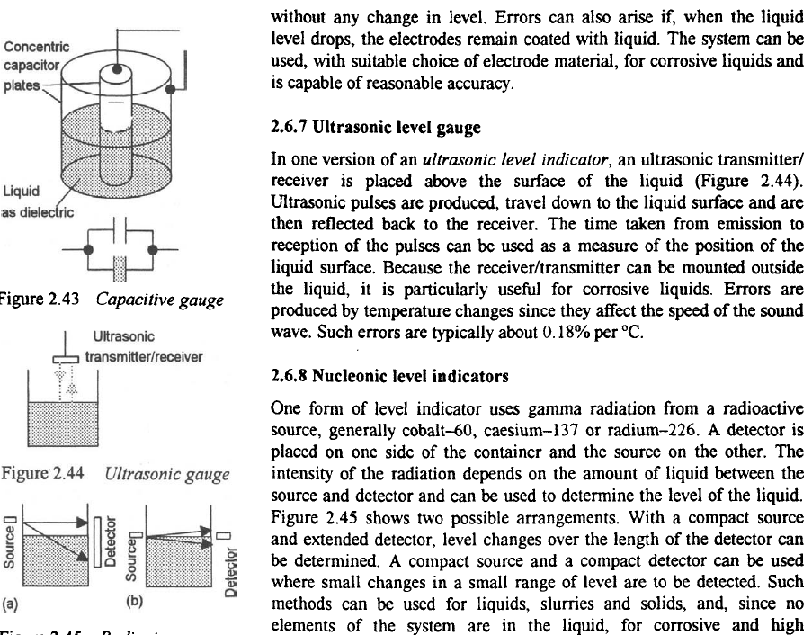

Slide 20
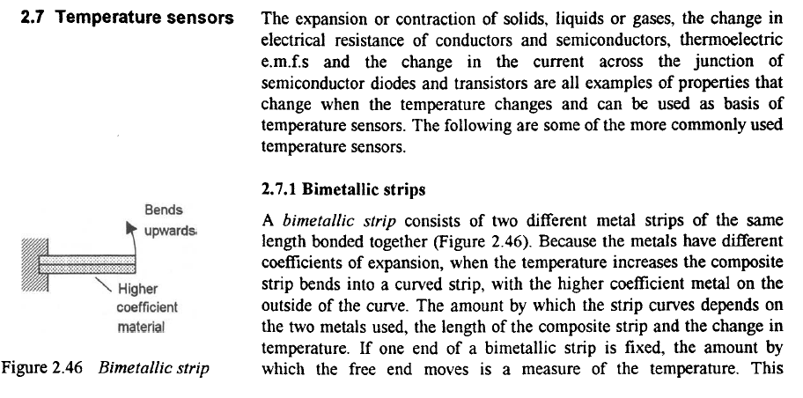

Slide 21
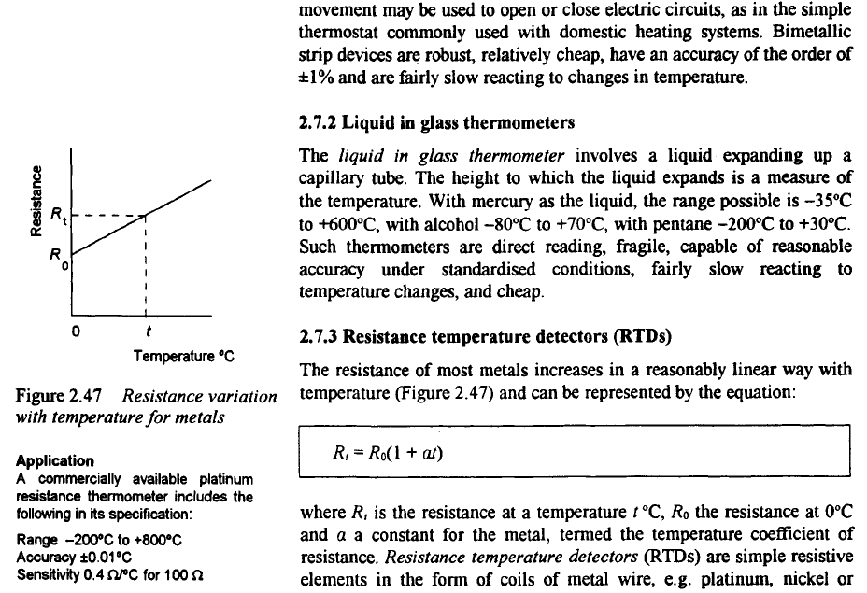

Slide 22
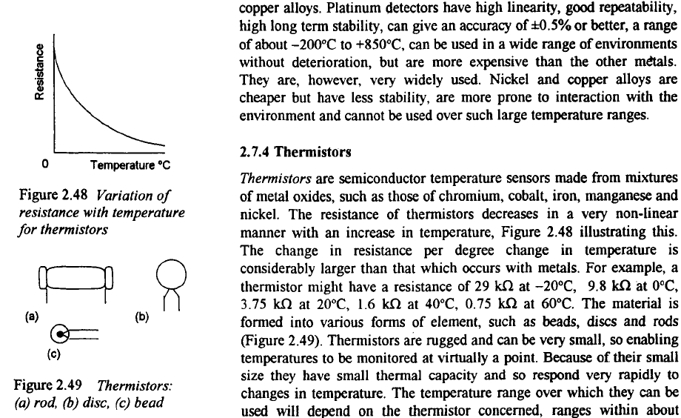

Slide 23
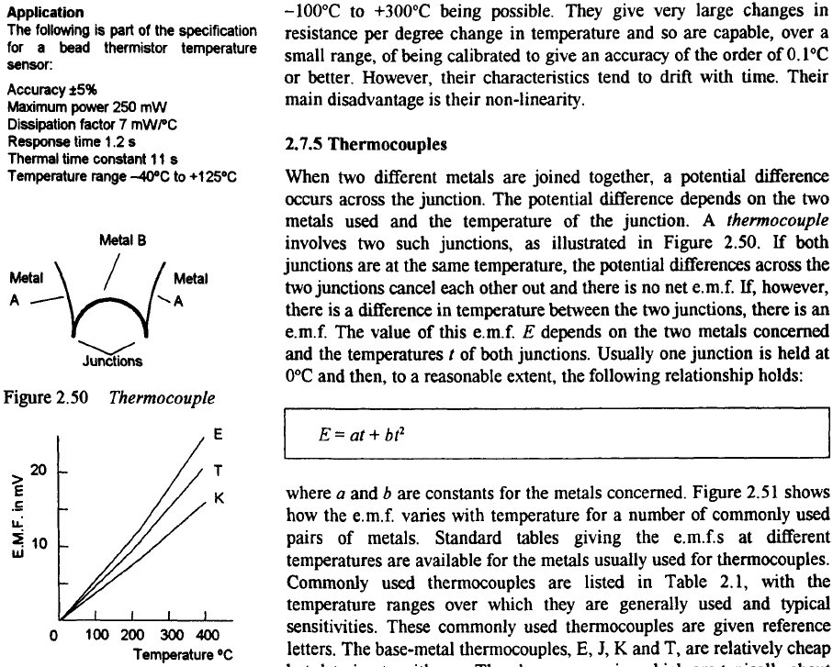

Slide 24
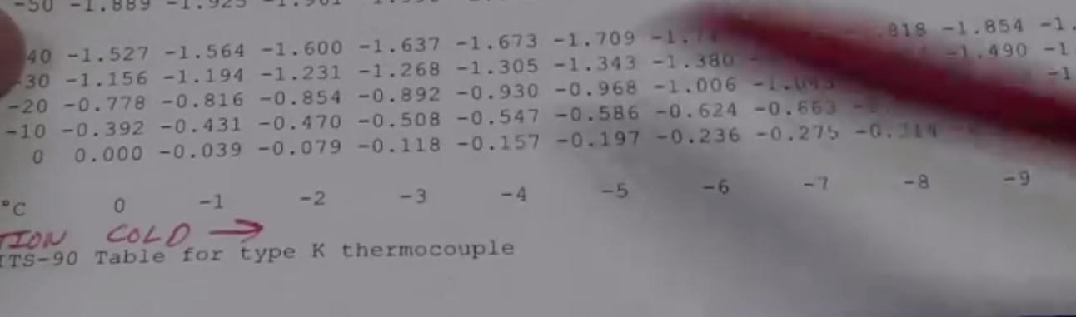
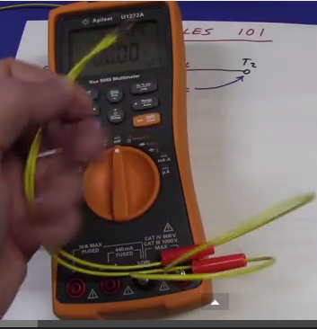
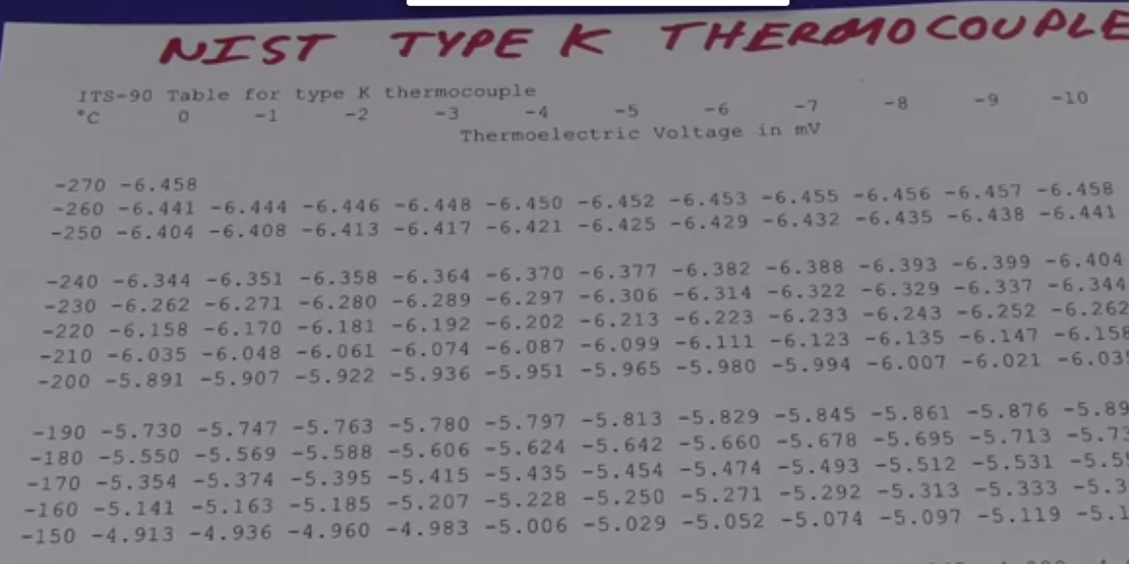

Slide 25
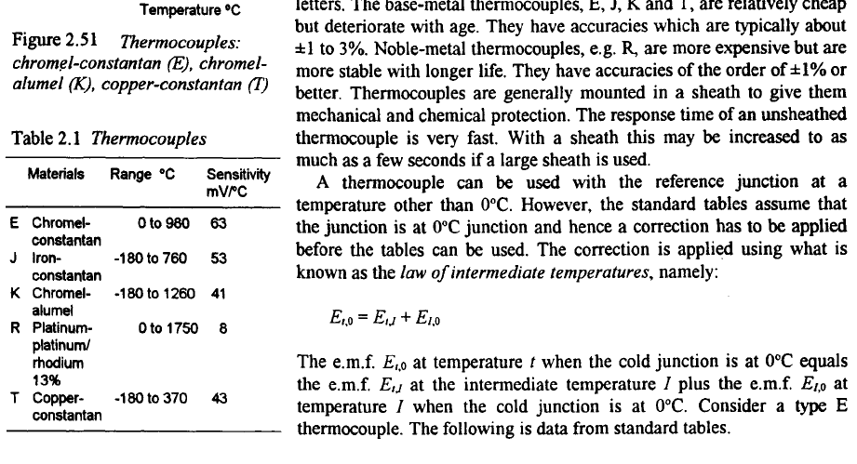

Slide 26
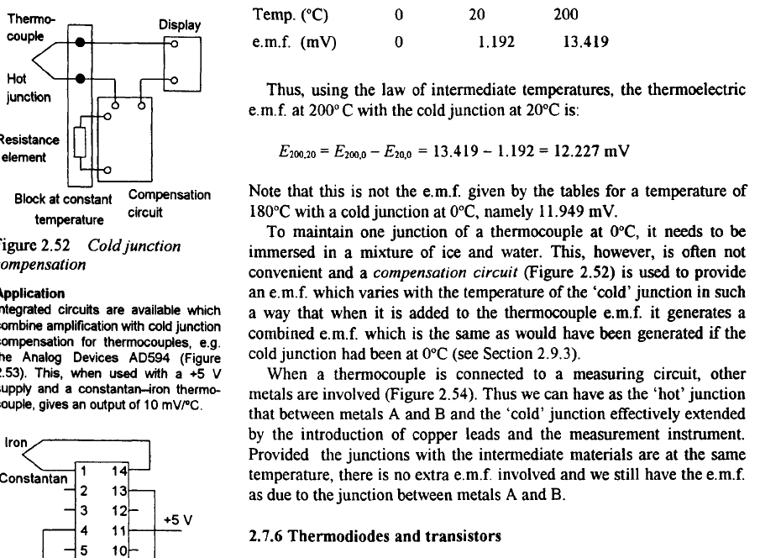

Slide 27
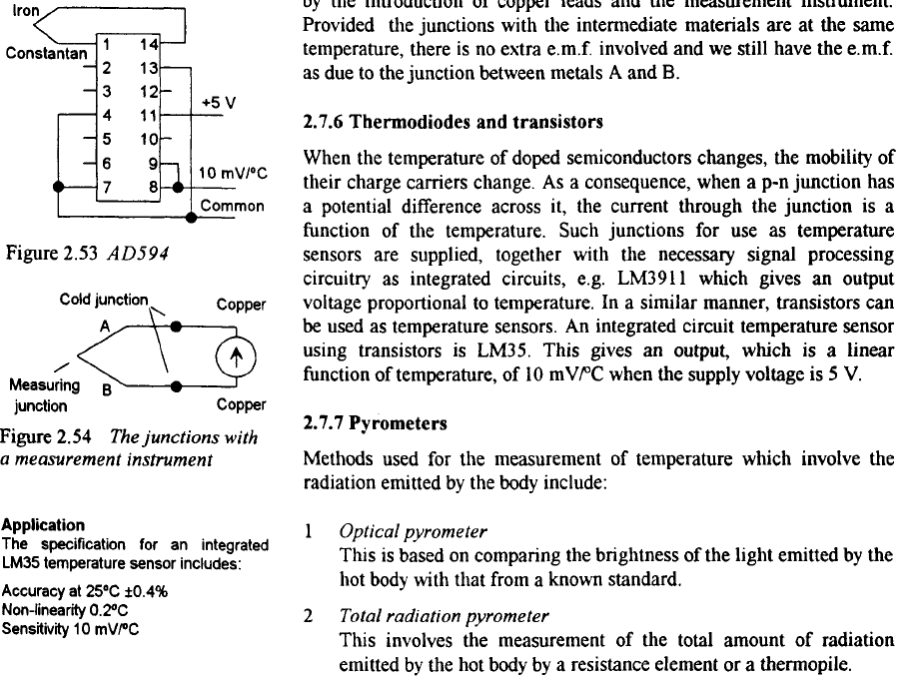

Slide 28
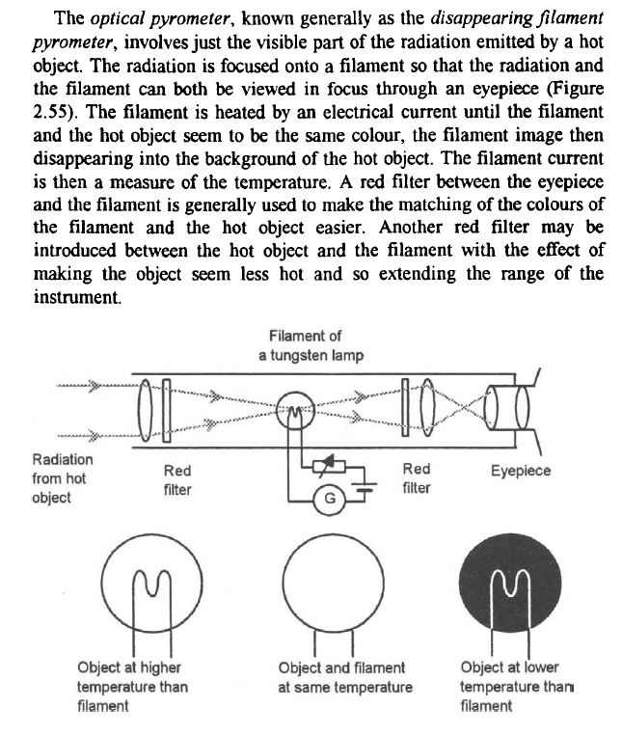

Slide 29
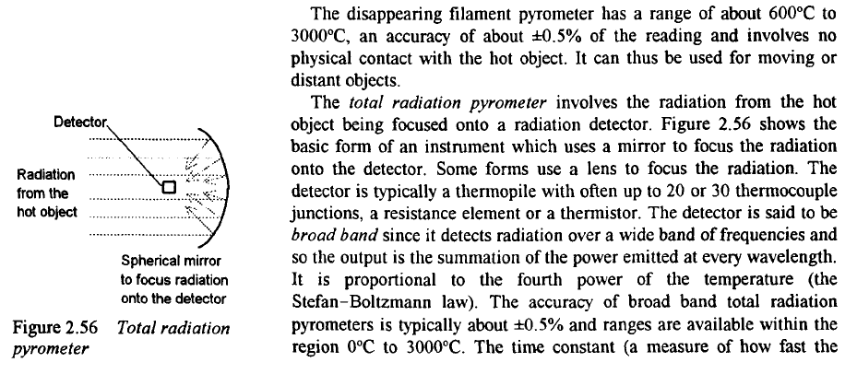

Slide 30
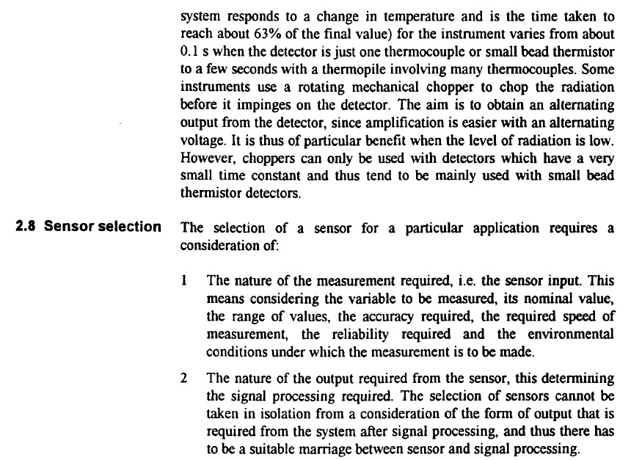

Slide 31
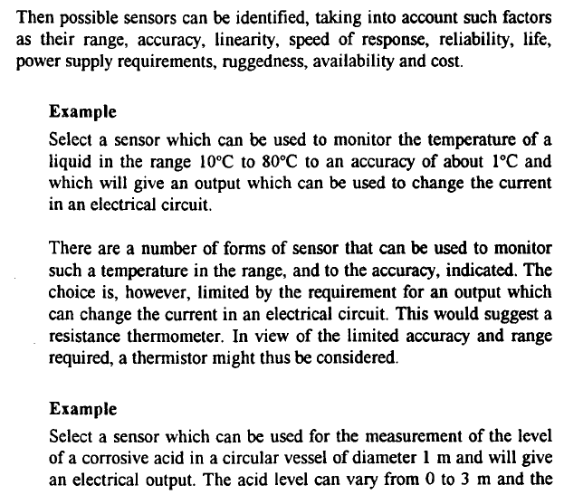

Slide 32
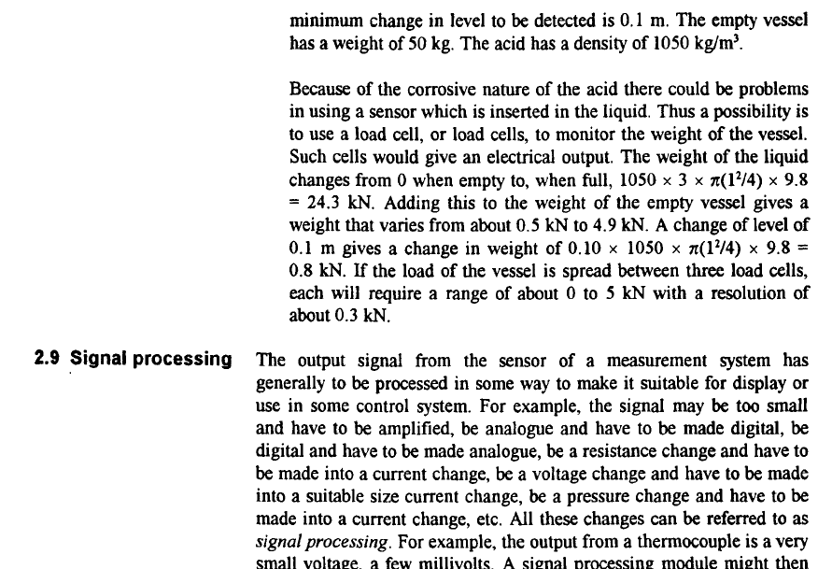

Slide 33
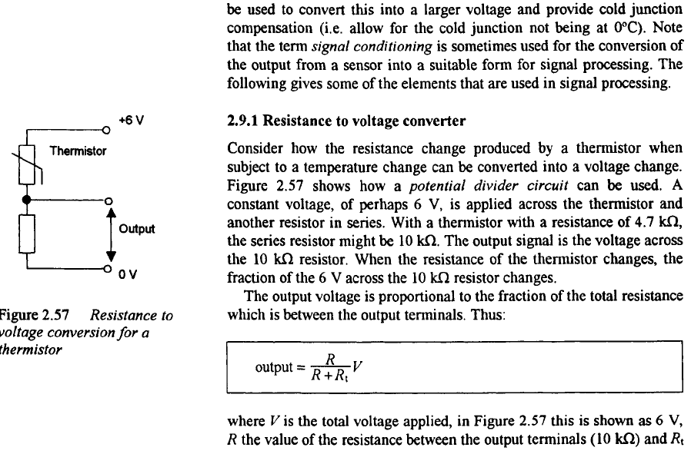

Slide 34
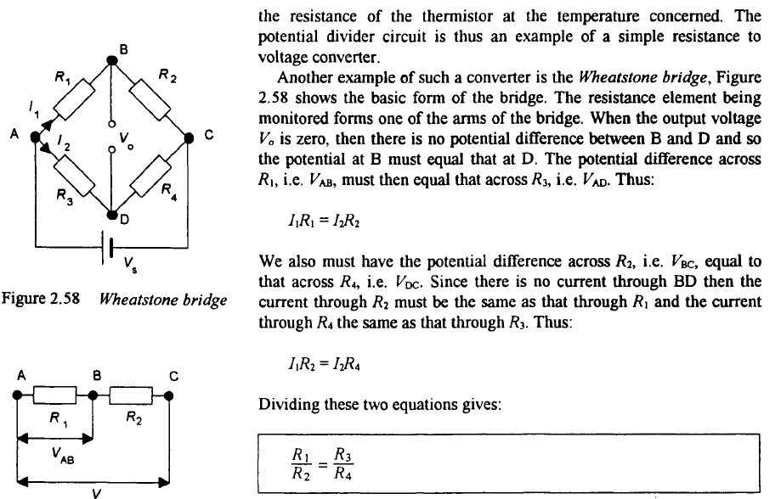

Slide 35
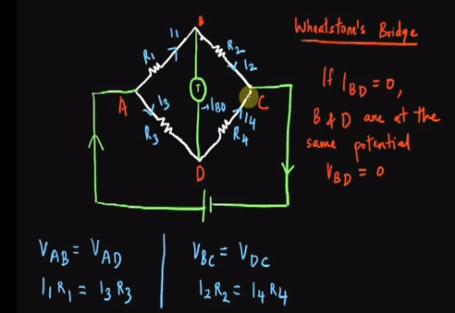

Slide 36
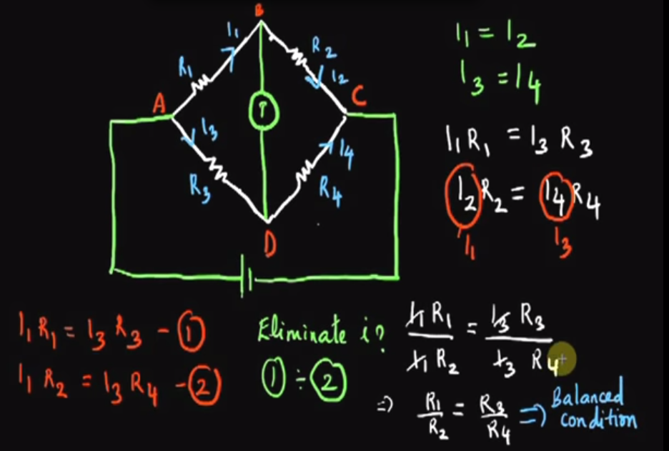

Slide 37
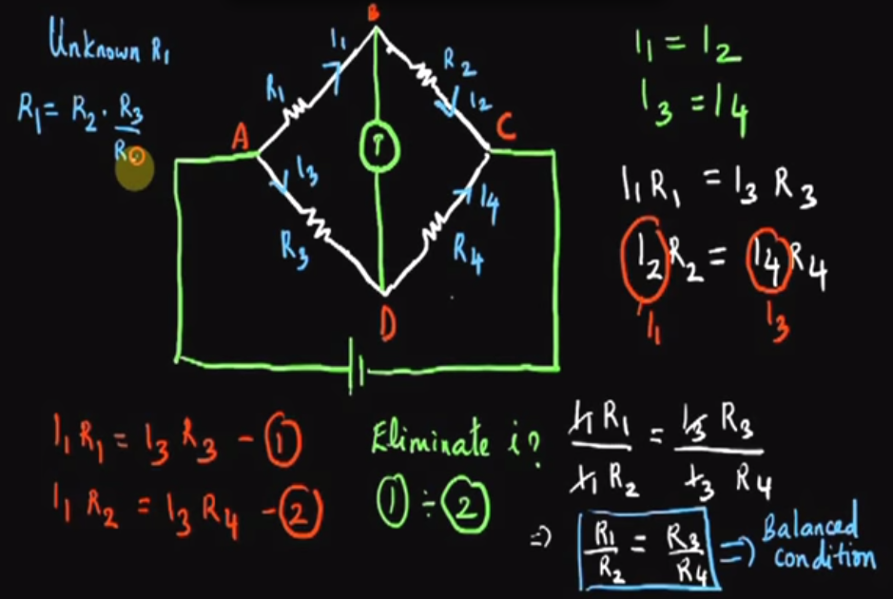

Slide 38
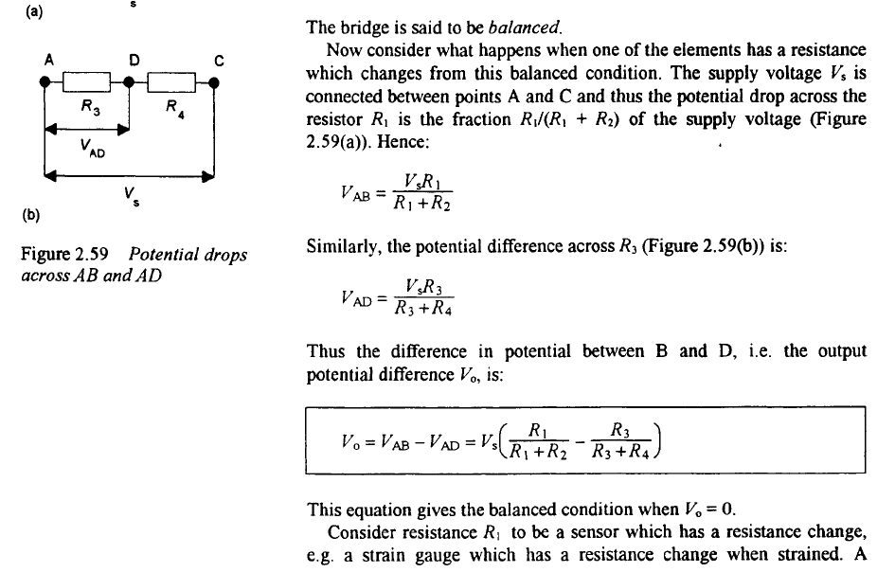

Slide 39
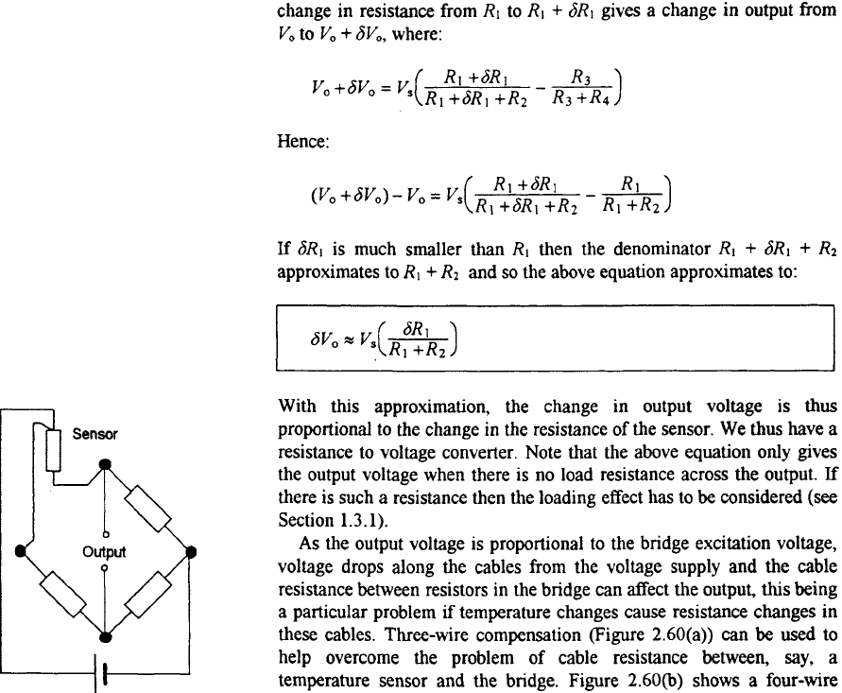

Slide 40
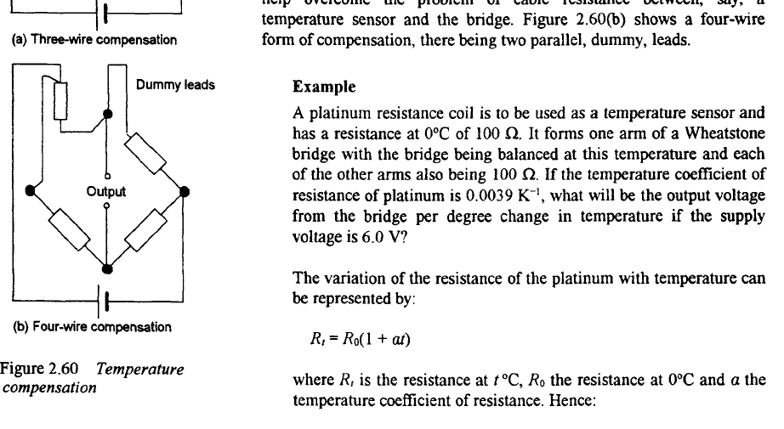

Slide 41
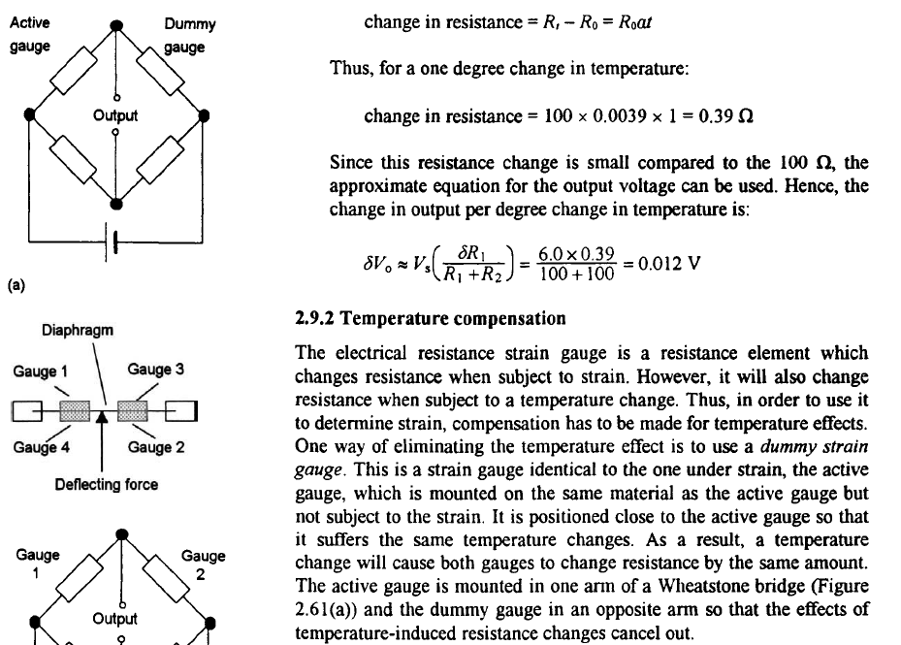

Slide 42
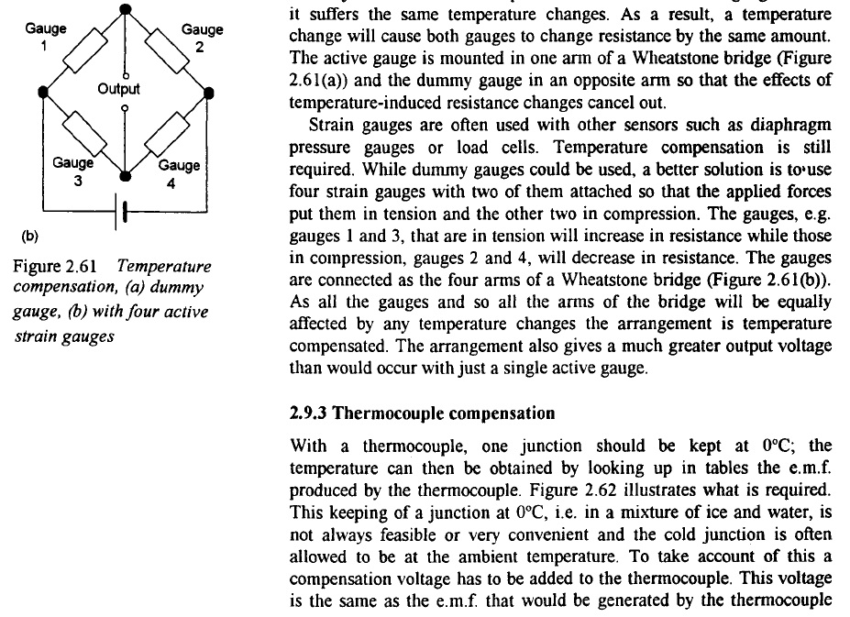

Slide 43
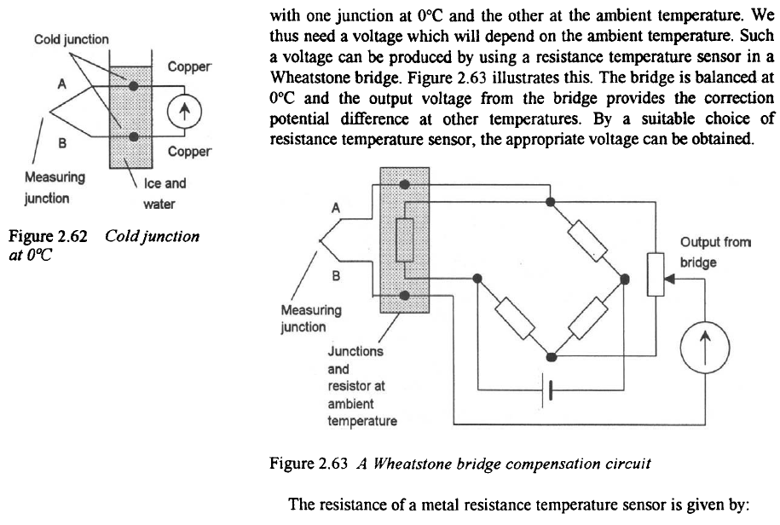

Slide 44
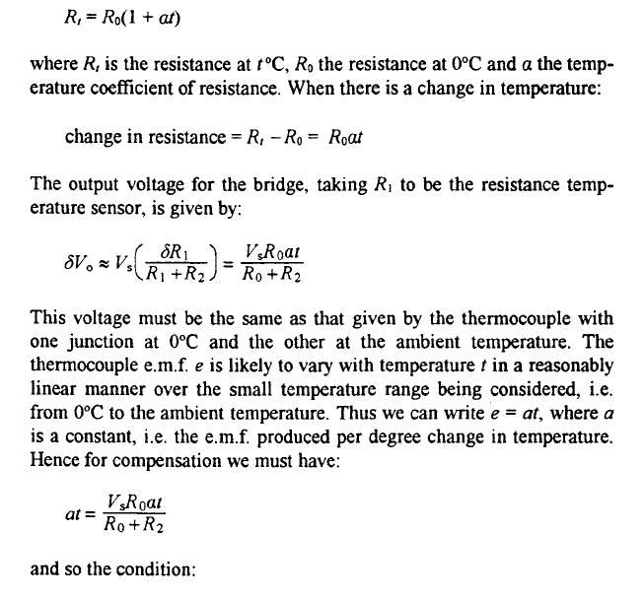

Slide 45
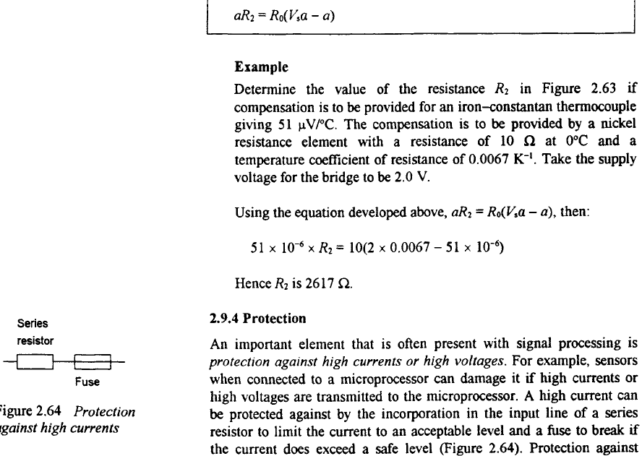

Slide 46
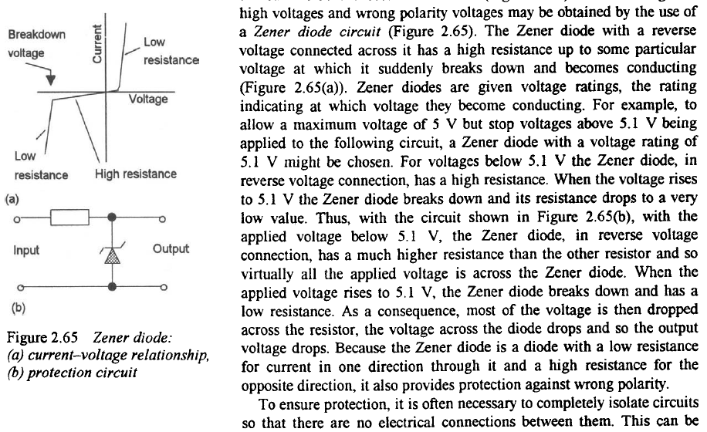

Slide 47
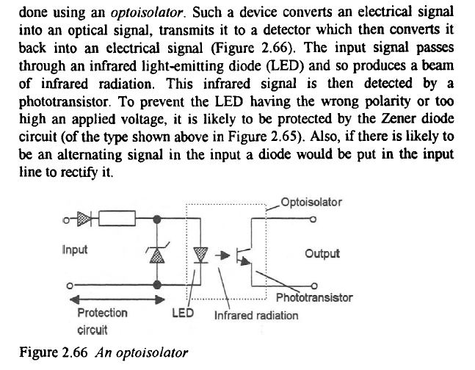

Slide 48
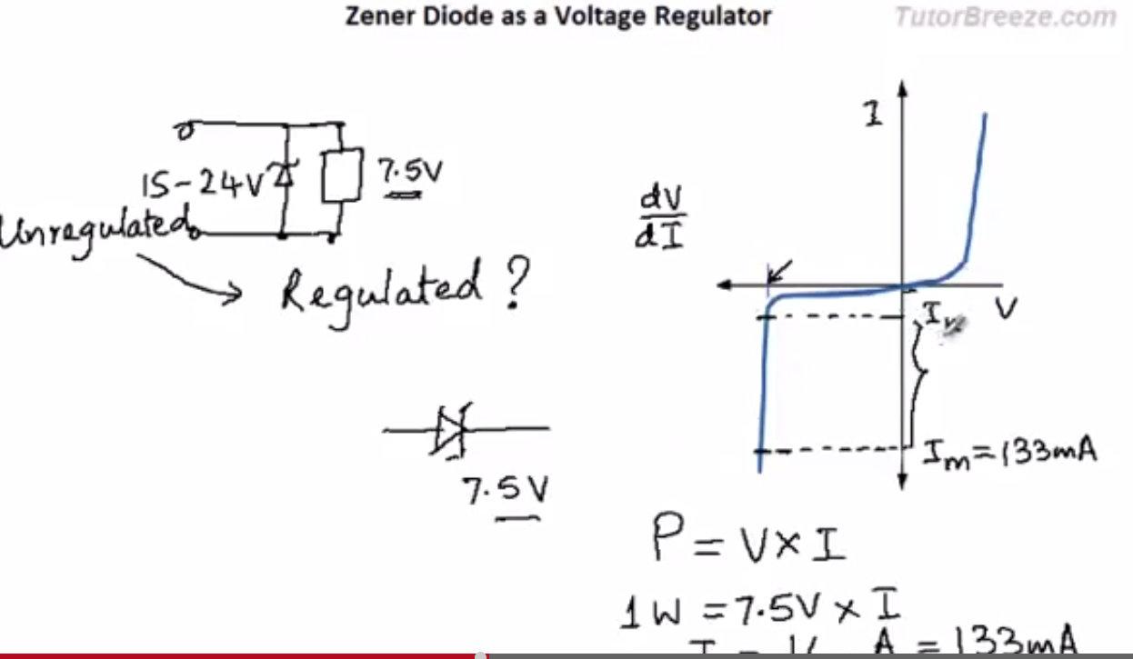

Slide 49
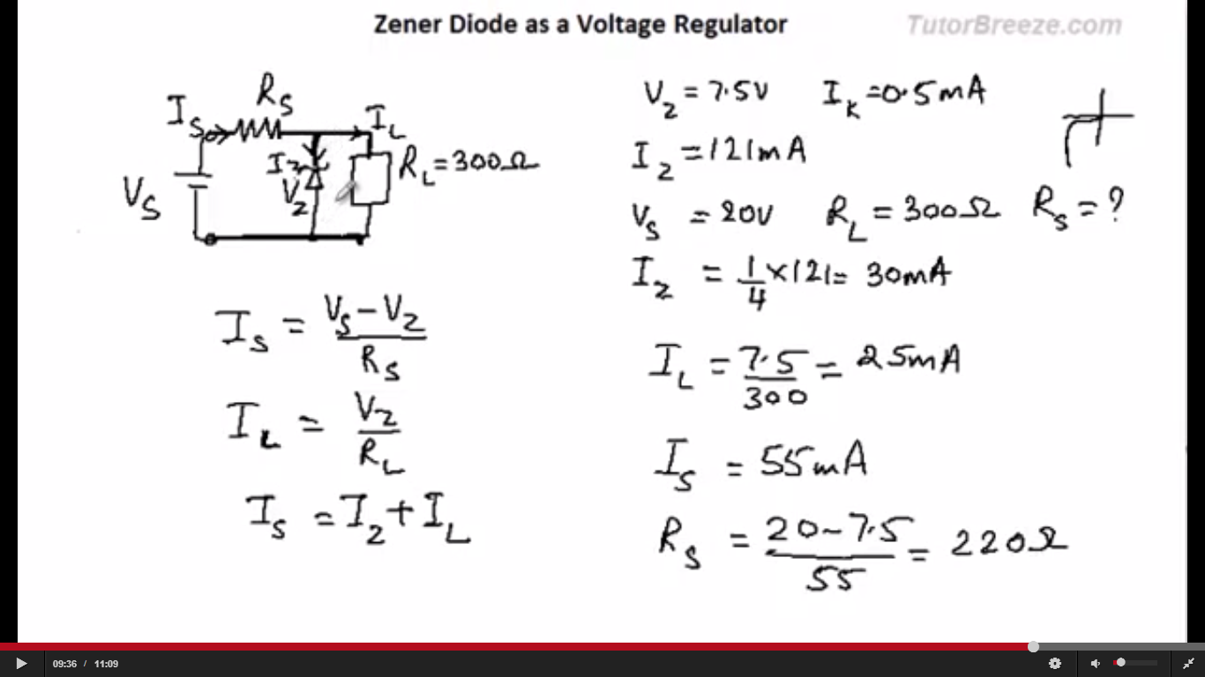

Slide 50


Slide 51


Slide 52


Slide 53


Slide 54


Slide 55


Slide 56


Slide 57


Slide 58


Slide 59


What is an Op-Amp? – The Surface
An Operational Amplifier (Op-Amp) is an integrated circuit that uses external voltage to amplify the input through a very high gain.
We recognize an Op-Amp as a mass-produced component found in countless electronics.
What an Op-Amp looks like to a lay-person
What an Op-Amp looks like to an engineer

Slide 60


Slide 61


Slide 62


Slide 63


Slide 64


Slide 65


Slide 66


Slide 67


Slide 68


Slide 69


Slide 70


Slide 71


Slide 72


Slide 73


Slide 74


Slide 75


Slide 76


Slide 77


Slide 78


Slide 79



Applications of Op-Amps
Filters
Types:
Low pass filter
High pass filter
Band pass filter
Cascading (2 or more filters connected together)
Low pass filter
C
R₂
R₁
+ V_{cc}
Low pass filter transfer function➔
-
+
+
V₀
__
- V_{cc}
+
-
Low pass filter Cutoff frequency ➔

Slide 80


Applications of Op-Amps
Electrocardiogram (EKG) Amplification
  Need to measure difference in voltage from lead 1 and lead 2
  60 Hz interference from electrical equipment

Slide 81


Applications of Op-Amps
Simple EKG circuit
  Uses differential amplifier to cancel common mode signal and amplify differential mode signal
Realistic EKG circuit
  Uses two non-inverting amplifiers to first amplify voltage from each lead, followed by differential amplifier
  Forms an “instrumentation amplifier”

Slide 82


Strain Gauge
Use a Wheatstone bridge to determine the strain of an element by measuring the change in resistance of a strain gauge
(No strain) Balanced Bridge
R #1 = R #2
(Strain) Unbalanced Bridge
R #1 ≠ R #2

Slide 83

Strain Gauge
Half-Bridge Arrangement
Op amp used to amplify output from strain gauge
R + ΔR
R_{f}
R
V_{ref}
+ V_{cc}
+
-
+
+
V₀
__
-
R
- V_{cc}
R - ΔR
R_{f}
Using KCL at the inverting and non-inverting terminals of the op amp we find that ➔
ε ~ V_{o} = 2ΔR(R_{f} /R²)

Slide 84


Applications of Op-Amps
Piezoelectric Transducer
  Used to measure force, pressure, acceleration
  Piezoelectric crystal generates an electric charge in response to deformation
Use Charge Amplifier
  Just an integrator op-amp circuit

Slide 85
PID Controller – System Block Diagram
P
V_{SET}
V_{ERROR}
I
Output Process
V_{OUT}
D
V_{SENSOR}
Sensor
Goal is to have V_{SET} = V_{OUT}
Remember that V_{ERROR} = V_{SET} – V_{SENSOR}
Output Process uses V_{ERROR} from the PID controller to adjust V_{out} such that it is ~V_{SET}

Slide 86

Applications
PID Controller – System Circuit Diagram
Signal conditioning allows you to introduce a time delay which could account for things like inertia
System to control
Calculates V_{ERROR} = -(V_{SET} + V_{SENSOR})
-V_{SENSOR}
Source: http://www.ecircuitcenter.com/Circuits/op_pid/op_pid.htm

Slide 87

Applications
PID Controller – PID Controller Circuit Diagram
Adjust | Change
K_{p} | RP1, RP2
K_{i} | RI, CI
K_{d} | RD, CD
V_{ERR}
V_{ERR PID}

Slide 88


Applications of Op-Amps
Example of PI Control: Temperature Control
Thermal System we wish to automatically control the temperature of:
Block Diagram of Control System:

Slide 89

Applications of Op-Amps
Example of PI Control: Temperature Control
Voltage Error Circuit:
Proportional-Integral Control Circuit:

